Slide 1


PYTHON
PROJECT
Premium prediction model

Slide 2

Project Overview
The dataset contains 278861 insurance policy transactions across 18 features, including financial & credit information, Insurance & claim history. Health & life style, Vechile & Property Details, Customer Sentiment, Premium Amount.
To develop a machine learning model that accurately predict premium amount transactions by analyzing patterns in transaction behavior, customer demographics.
The goal is to predict the premium a person would be charged helping insurer optimizing pricing stratigies.

Slide 3
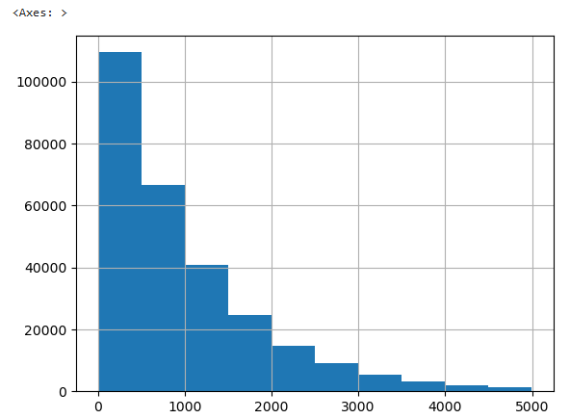
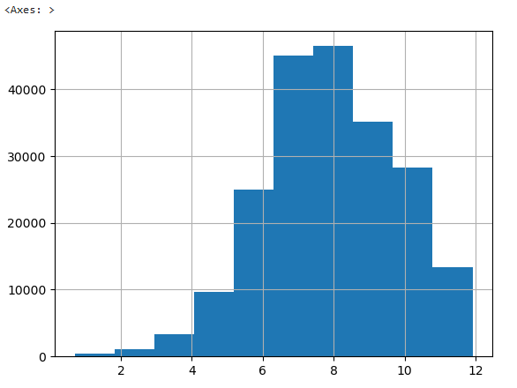
Target Variable
Transformation Process:
Removed "Rarely" exercisers
Adjusted Premiums:
Weekly ×4, Daily ×30
Applied log transformation
Final target: premium_log
Initial Target: Premium Amount
Visual Insight:
The Premium Amount showed extreme right skewness.
Most values clustered around the lower end.
Result:
premium_log shows improved, near-normal distribution.
Better suited for predictive modeling.

Slide 4
Data Preprocessing
Objective
Ensure all numerical features are on the same scale to improve model performance.
Prevent features with larger ranges from dominating others during training
Applied Label Encoder to transform categorical variable:
Exercise Frequency to numerical values
Feature Scaling
Method: Min-Max Scaling
Scales each feature to a range between 0 and 1.
Benefits
Helps algorithms like Linear Regression to perform better.
Speeds up convergence in gradient-based models.
Ensures fair feature contribution in distance-based calculations

Slide 5
Missing Value Treatement
Continuous Columns :
Health Score
Annual Income
Age
Credit Score
Premium Amount
Categorical Columns:
Customer Feedback
Marital Status
Occupation
Previous Claims
Number of Dependents
Used Median for robustness in Continuous
Used Mode for consistency in Categorical

Slide 6
Statistical Feature selection
Continuous (Correlation Test)
To identify categorical features that are statistically associated with the target variable is premium_log.
If the correlation test value is less than 0.05, it means the result is statistically significant
Feature | Correlation with premium_log | Strength
Annual Income | Low (< 0.5) | Weak
Health Score | Low (< 0.5) | Weak
Credit Score | Low (< 0.5) | Weak
Since Annual income, Health score, Credit score has correlation value < 0.05 this means they are statistically significant.

Slide 7
Statistical Feature selection
Categorical (ANOVA Test)
Categorical Feature | P-Value | Significance
Customer Feedback | 0.9786 | ❌ Not Correlated
Previous Claims | 0.4156 | ❌ Not Correlated
Occupation | 0.5976 | ❌ Not Correlated
Marital Status | 0.6260 | ❌ Not Correlated
Number of Dependents | 0.3034 | ❌ Not Correlated
Gender | 0.4618 | ❌ Not Correlated
Property Type | 0.6313 | ❌ Not Correlated
Exercise Frequency | 0.0000 | ✅ Correlated
Smoking Status | 0.4709 | ❌ Not Correlated
Insurance Duration | 0.3514 | ❌ Not Correlated
Vehicle Age | 0.4974 | ❌ Not Correlated
Policy Type | 0.1313 | ❌ Not Correlated
Location | 0.4245 | ❌ Not Correlated
Education Level | 0.1154 | ❌ Not Correlated
To identify categorical features that are statistically associated with the target variable is premium_log.
If the p-value is less than 0.05, it means the result is statistically significant

Slide 8
Model Building– Linear Regression
Model: Linear Regression
Target Variable: premium_log
R² Score: 0.19
Metric | Value
Mean Accuracy | 78.59%
Median Accuracy | 85.13%
Average Cross-Validation Accuracy: 78.54%

Slide 9
Model Building– Decision Tree
Model: DecisionTreeRegressor
Parameters: max_depth=5, criterion='squared_error'
Target Variable: premium_log
Training R² Score: 0.55
Metric | Value
Mean Accuracy | 84.64%
Median Accuracy | 90.19%
Final Average Accuracy: 84.79%

Slide 10
Model Building– Random Forest
Model: RandomForestRegressor
Parameters: max_depth=2, n_estimators=400, criterion='squared_error'
Target Variable: premium_log
Training R² Score: 0.55
Metric | Value
Mean Accuracy | 84.65%
Median Accuracy | 90.19%
Average Accuracy: 84.79%

Slide 11
Model Selection Justification
Random Forest
Because
It provides the highest and most consistent accuracy across all metrics (mean, median, and cross-validation).
It is more robust than a single decision tree due to ensembling.
Despite similar performance to Decision Tree in this setup, Random Forest is less prone to overfitting and handles variance better.

Slide 12





Thank's For Watching
Connect with us.
+7029689216
paswanaman43@gmail.com

